Slide 1



Introduction to Bootstrap
Bootstrap is a popular CSS framework that provides a foundation for building responsive websites and web applications. It includes a set of pre-defined styles and components that help to create clean and consistent designs.
by Meet Mehta

Slide 2



Background Properties
Background Color
Background Images
Use the "bg-*" utilities to apply background colors to your elements. For example, "bg-primary" will set the background color to the primary color of Bootstrap.
Use the "bg-image" utility class to apply a background image to an element. You can also customize the image size, position, and repeat using CSS properties.
Background Gradients
Bootstrap offers classes to create linear gradients for backgrounds. Use the "bg-gradient-*" utility classes for different gradient combinations.

Slide 3
Border Properties
Border Width
Border Style
Border Color
Use the "border-*" utilities to set the border width. For example, "border-top-2" will add a 2px border to the top of the element.
Customize the border style using "border-*" utilities. Examples include "border-dashed", "border-dotted", and "border-solid".
Set the border color with "border-*" utilities. For instance, "border-primary" applies the primary color as the border color.

Slide 4

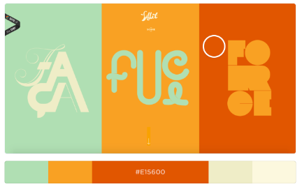
Color Utilities
1
Text Colors
2
Background Colors
Use "text-*" utilities to change text colors. Examples include "text-primary", "text-secondary", and "text-white".
Apply background colors to elements using "bg-*" utilities. For instance, "bg-success" sets the background color to green.
3
Color Themes
4
Custom Colors
Bootstrap provides a set of pre-defined color themes, such as "primary", "secondary", and "danger", which you can apply to various elements.
You can also define custom colors in your CSS and use them with Bootstrap's utility classes.

Slide 5


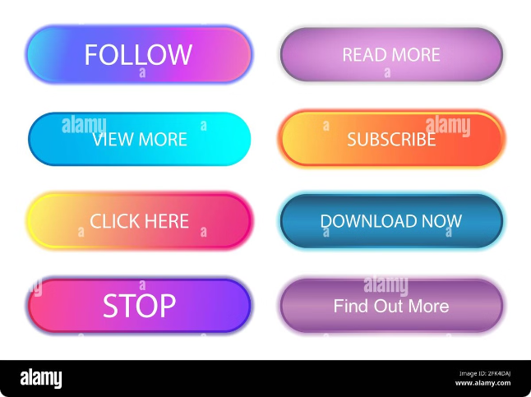


Shadow Utilities
Box Shadows
Add a box shadow to elements using "shadow-*" utilities. For example, "shadow" applies a subtle box shadow.
Shadow Intensity
Adjust the shadow intensity using utilities like "shadow-sm" for a light shadow and "shadow-lg" for a stronger shadow.
Custom Shadows
You can create custom shadows by adding your own CSS rules with specific shadow values.

Slide 6


Text Utilities
Utility
Description
text-uppercase
Sets the text to uppercase.
text-lowercase
Sets the text to lowercase.
text-capitalize
Capitalizes the first letter of each word.
text-center
Aligns the text to the center.

Slide 7


Responsive Design
1
Breakpoints
Bootstrap uses breakpoints to adjust the layout and styles for different screen sizes. It defines breakpoints for small, medium, and large screens.
2
Grid System
Bootstrap's grid system is responsive, allowing you to create flexible layouts that adapt to different screen sizes.
3
Utility Classes
Utilize responsive utility classes to control the visibility and styling of elements at different breakpoints. Examples include "d-none", "d-md-block", and "d-lg-flex".

Slide 8


Conclusion
Bootstrap is a valuable tool for front-end development. It provides a strong foundation for building beautiful and responsive websites. Use the features and guidelines discussed to create engaging and accessible web experiences.

